Slide 1


UNIVERSITY OF BASRA
COLLEGE OF MEDICINE
DEPARTMENT OF PATHOLOGY AND FORENSIC Medicine
Macrocytic anemia
Dr. Ala’a A.Razak Abood
Iraqi Board of Haematopathology

Slide 2
Objectives:
Define macrocytic anemia and mention the major causes.
Define megaloblastic anemia and descipe its pathogenesis.
Pernicious anemia: definition, cause, pathogenesis and and diagnosis.
Assess haematological response to treatment in patient with megaloblastic anemia

Slide 3

Definition:
Macrocytic anaemia: is a type of anemia in which the red cells are abnormally large (mean corpuscular volume, MCV > 98 fL).

Slide 4
Causes of macrocytosis:

Slide 5


Slide 6
Definition:
Defined as a group of anaemias in which the erythroblasts in the bone marrow show a characteristic abnormality – maturation of the nucleus being delayed relative to that of the cytoplasm.

Slide 7
Pathogenesis of megaloblastic anemia:
The underlying defect accounting for the asynchronous maturation of the nucleus is defective DNA synthesis and this is usually caused by deficiency of vitamin B 12 or folate. Less commonly, abnormalities of metabolism of these vitamins or other lesions in DNA synthesis may cause an identical haematological appearance.

Slide 8
Vitamin B 12 (Cobalamine)

Slide 9
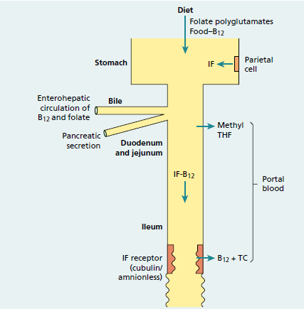
Absorption:

Slide 10
Biochemical Function:

Slide 11
Deficiency :

Slide 12
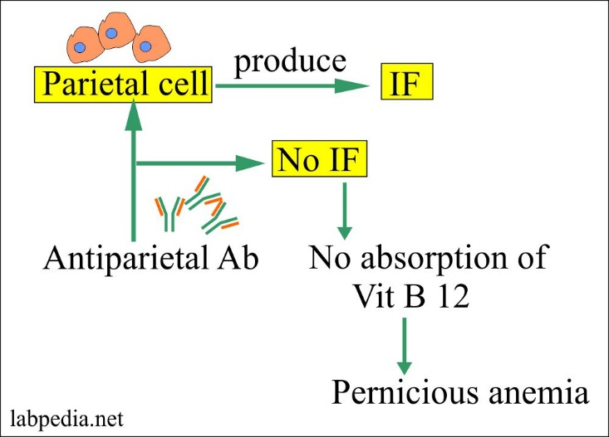
Pernicious anemia :

Slide 13
Folate:

Slide 14
Absorption, transport and function :

Slide 15
Deficiency :

Slide 16
Clinical Features of Megaloblastic Anemia

Slide 18
Vitamin B 12 neuropathy
( subacute combined degeneration of the cord)

Slide 19
Neural tube defect

Slide 20
Laboratory Findings of Megaloblastic Anemia
- Macrocytic anemia with typically oval macrocytes
- Hypersegmented neutrophils

Slide 22
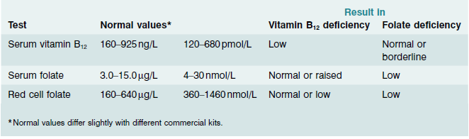
Diagnosis of vitamin B 12 or folate deficiency:

Slide 23
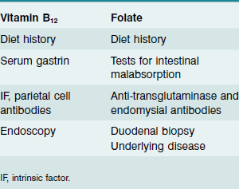
Tests for cause of vitamin B 12 or folate deficiency

Slide 24
Haematological response to therapy:

Slide 25


